Slide 1
IT Strategy 2024-25
January 15, 2024
How IT will support Earlham College’s Strategic Priorities in FYs 24-25

Slide 2
Message from the AVP of IT (CIO)
Earlham College IT Strategy 24-25
What is Earlham’s 24-25 IT strategy?
This strategy document provides an overview of Information Technology Services’ (ITS) direction over the next 2-3 years. It indicates how ITS will align resources, efforts, and budget to support Earlham’s strategic goals and priorities.
ITS leadership and the Technology Advisory Council (TAC) formed this strategy based on input from more than 100 members of the Earlham community as well as the entire ITS team. The key initiatives described in this document will support achievement of the College’s mission and goals.
Thank you to all who helped assess our current state, envision our future state, and prioritize initiatives to close the associated gaps. I look forward to working with all of you in helping Earlham College achieve its strategic goals and objectives.
Michael Bottorff,
Associate Vice President of Information Technology
*Insight: Everything ITS does should support the organization. A good strategy links IT initiatives to organizational goals and objectives. A well-crafted strategy enhances community satisfaction and strengthens relationships.

Slide 3
Earlham College IT Strategy 24-25
Earlham College 24-26 IT Strategy At-A-Glance
The top IT initiatives directly align with Earlham’s key initiatives and improve IT product and service delivery. The FY24-26 strategy will shift ITS into a strategic enabler for the College.
ORGANIZATIONAL SUPPORT
Increase Customer Satisfaction to*
85%
Build an IT staff development plan
Implement Microsoft software ecosystem
Assess and improve Banner environment
Select and implement new housing software
Right-size and update student computers
Update and improve role-based permissions
Right-size and refresh printer fleet
Select and implement new advancement software
Implement security awareness and training program
Develop and implement ITS communications plan
J | F | M | A | M | J | J | A | S | O | N | D
Innovator
*IT stakeholder satisfaction data
Target
Business Partner
IT EXCELLENCE
Raise % of Highly Effective IT Processes to*
20%
Trusted Operator
J | F | M | A | M | J | J | A | S | O | N | D
Develop and implement IT asset management strategy
Implement new cloud-based email spam filter
Establish software implementation standards
Review and update service desk processes
Select and implement new service desk software
Deploy Windows 11
Build a software catalog
Current
Firefighter
*IT management and governance diagnostic data
Unstable
INNOVATION
Improve IT Innovation Leadership score by*
10%
J | F | M | A | M | J | J | A | S | O | N | D
Build a comprehensive data strategy
Assess potential for AI to enhance service desk
*Info-Tech Maturity Assessment
* IT vision stakeholder satisfaction and CEO-CIO alignment data

Slide 4
Earlham College IT Strategy 24-25
Key IT initiatives align with Earlham Strategic Goals
Business Goals
Recruit and retain a welcoming, diverse and inclusive community of faculty, staff and students.
Build a financially sustainable path for Earlham.
Improve student success and experience (retention, graduation, preparation for next steps in life)
Establish strong and enduring relationships on- and off-campus.
Create a culture of continuous improvement and assessment.
Selected IT Initiatives
Build an IT staff development plan Implement Microsoft software ecosystem Optimize IT staffing Right-size and update student computers (labs and shared devices) Optimize Slate Develop and implement user training program
Develop and implement IT asset management strategy Create a right-sized disaster recovery plan Build an information security strategy Update and improve role-based permissions and access Right-size and refresh printer fleet Improve IT spending and budgeting
Select and implement new residential management software Develop a classroom technology plan Design and implement ITS student worker program Evaluate and improve Presence and Handshake Improve campus-wide digital signage
Develop and implement IT strategy Review and update service desk processes Improve requirements gathering Select and Implement new advancement software Develop and implement ITS communications plan
Establish IT governance Assess and improve Banner environment Determine and implement long-term Banner strategy Build a comprehensive data strategy Develop a security awareness and training program Review and improve IT policies Identify and track IT performance measures
IT Goals
Organizational Support
IT Excellence
Innovation
Achieved through
Achieved through

Slide 5
Earlham’s mission and principles frame IT strategy
Earlham College IT Strategy 24-25
Earlham College
Mission
To provide the highest quality undergraduate education in the liberal arts, including the sciences, shaped by the distinctive perspectives of the Religious Society of Friends (Quakers).
Principles & Practices
Respect for Persons
Integrity
Peace and Justice
Simplicity
Community
Information Technology Services (ITS)
Mission
ITS provides innovative technology and services that empower Earlham to fulfill its educational mission. ITS accomplishes this through highly skilled IT staff, best fit solutions, a sustainable technical infrastructure, and adherence to the College's Principles and Practices.
Vision
A trusted partner and technology leader delivering the highest quality customer experience.
Guiding Principles
Simplicity
Enterprise Value
Standardization
Customer Focus
Innovation

Slide 6
Earlham’s strategic objectives guide IT strategy
Earlham College IT Strategy 24-25
Strategic Initiatives | Recruit and retain a welcoming, diverse and inclusive community of faculty, staff and students. | Build a financially sustainable path for Earlham. | Improve student success and experience (retention, graduation, preparation for next steps in life | Establish strong and enduring relationships on- and off-campus. | Create a culture of continuous improvement and assessment.
Earlham College IT Strategy 24-26

Slide 7
Earlham College PESTLE Analysis – Spring 2023
Earlham College IT Strategy 24-25
Political | Visa restrictions impact ability to recruit international students Possible state-level restrictions on endowment use Uncertainty over student aid policies | Uncertainty over student aid policies Demand for more practical programs Inflationary impact on salary demands Increasing technology costs Possible restrictions on endowment use | Economic
Social | Trend of more lower income students Less international and in-state students Expectations regarding digital offerings for student experience | Security (permissions, access, etc.) Demand for improved collaboration tools Demand for improved data governance, integration and analytics capabilities Need for refresh budget cycle Student lab and classroom technology upgrades Improved use of finance/HR/student data systems Impact and/or potential of advanced AI technologies (e.g. Chatbots, student predictors of success, etc.) | Technological
Legal | Data privacy (e.g. FERPA, GDPR) Ever changing federal, state reporting & compliance demands GLBA security requirements | Disaster recovery strategy in dealing with weather events and power outages | Environment
Earlham College IT Strategy 24-26

Slide 8
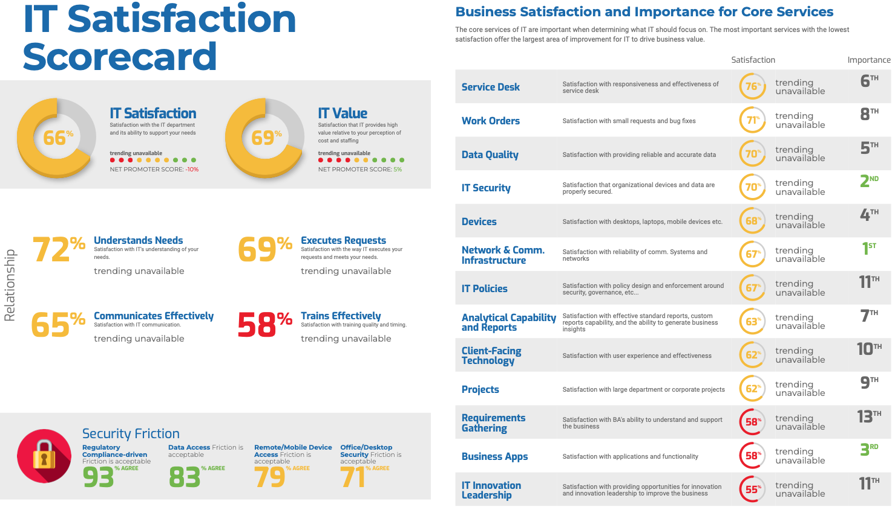
IT Customer Satisfaction - Spring 2023
Earlham College IT Strategy 24-25
IT will focus on the highest importance, but lowest performing services and capabilities to drive improved satisfaction levels and enhance IT service delivery maturity.

Slide 9
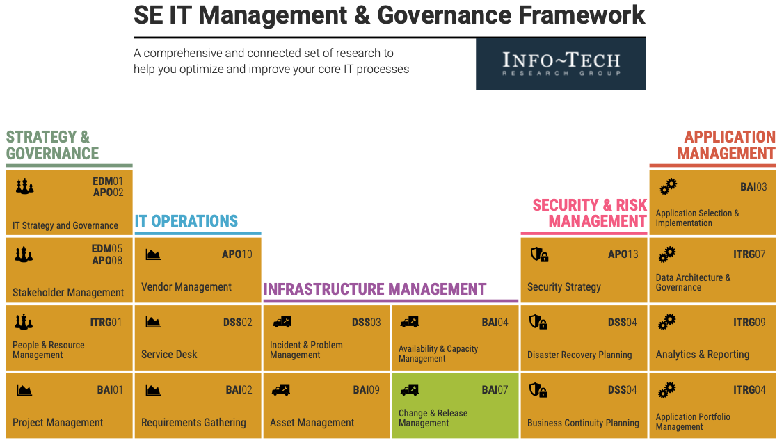
IT Process Capabilities - Spring 2023
Earlham College IT Strategy 24-25
Legend: survey results
High Importance
And High Effectiveness
Low Importance
And High Effectiveness
Low Importance
And Low Effectiveness
High Importance
And Low Effectiveness

Slide 10
Top IT Processes and Accountabilities - Spring 2023
Earlham College IT Strategy 24-25

Slide 11
IT SWOT Analysis - Spring 2023
Earlham College IT Strategy 24-25
Strengths (Internal) | Weaknesses (Internal)
Depth of staff knowledge and experience Service desk Staff customer service oriented Willingness to innovate Network infrastructure Being able to address specialized requests Change management Internal teamwork (understanding of roles and tools, communication, willingness to collaborate and pitch in) | Resource capacity (limited dollars and staff) Lack of IT Governance (federated, ad hoc decision-making, distributed IT spending, security vulnerabilities) Impact of not having CIO for lengthy period (e.g., no cheerleader to highlight IT accomplishments) Lack of process documentation in some areas (and user documentation) Data architecture and integration Business applications (e.g., productivity)
Opportunities (External) | Threats (External)
vCISO (GreyCastle) and managed infrastructure partner (Apogee) Improved tools and platforms (e.g, data backup and restoration, DNS management & security tool, centralized purchasing, active directory/Azure account management, email filtering) Improved use of existing tools (e.g., Banner audit/assessment) Better definition and implementation of role-based permissions and access Classroom technology more easily virtualized Seminary relationship(s) and support Automated workflow for common processes | Student enrollment Regulation & compliance changes Security (internal awareness, increasing external threats, phishing attempts, ransomware) Limited understanding of ITS’ capacity and capability to deliver solutions. Lack of clarity regarding IT alignment with college goals Limited coordination with ITS Lack of knowledge/training for data reporting & analytics Willingness of business to adopt innovation ideas (culture?) Shadow IT in various other departments

Slide 12
IT Maturity
Earlham College IT Strategy 24-25
IT in 2026
Innovator – Transforms the Business
Reliable Technology Innovation
The IT Strategy and Key Initiative Plan contain projects and initiatives focused on improving our vital core processes and capabilities, aimed at transforming ITS’s role to lead digital transformation at Earlham College.
Business Partner – Expands the Business
Effective Execution on Business Projects, Strategic Use of Analytics and Customer Technology
IT in 2025
Trusted Operator – Optimizes the Business
Effective Fulfillment of Work Orders, Functional
Business Applications, and Reliable Data Quality
IT Today
Firefighter – Supports the Business
Reliable Infrastructure and IT Service Desk
Unstable – Struggles to Support
Inability to Provide Reliable Business Services

Slide 13
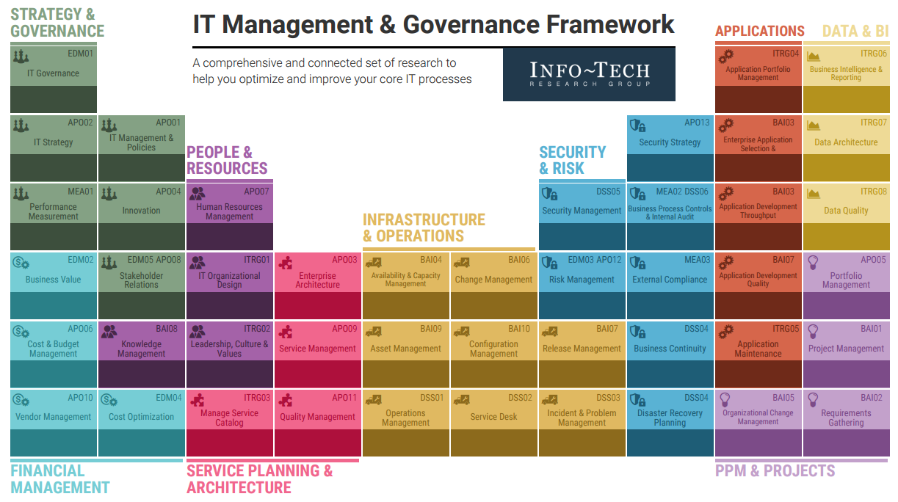
IT Process Improvement
Earlham College IT Strategy 24-25
Legend:
Improve process first
Improve process second
Improve process third
a

Slide 14
Key Initiatives – Overview
Earlham College IT Strategy 24-25
Support Major Organizational Priorities
1
Organizational Support
These projects deliver or enhance IT capabilities that support critical college operations and/or strategic initiatives.
+
2024-2026 IT Key Initiative Plan
Reduce Risk & Improve IT Operational Excellence
Our key initiatives collectively support Earlham’s strategic priorities and improve the delivery of IT services.
2
Improve IT Excellence
These projects will increase IT process maturity and systematically improve IT.
+
Drive Technology Innovation
3
Drive Innovation
These projects will improve our future innovation capabilities and decrease risk by increasing our technology maturity.

Slide 15
Key Initiatives – Organizational Support
Earlham College IT Strategy 24-25
Develop and implement IT strategy Build an IT staff development plan Select/implement new productivity ecosystem (multiple projects) Assess/improve Banner environment Establish IT governance Update Banner-Moodle Integration Determine/implement long-term Banner strategy Optimize IT staffing Select/implement new residential management software Improve requirements gathering Right-size and update student computers (labs and shared devices) Create a right-sized disaster recovery plan Update and improve role-based permissions and access Right-size and refresh printer fleet Implement security awareness and training program Select/implement new advancement software Optimize Slate Improve IT spending and budgeting Develop and implement ITS communications plan …14 additional projects
Organizational Support Initiatives/Projects
1

Slide 16
Key Initiative Roadmap – Organizational Support
Earlham College IT Strategy 24-25
INITIATIVE NAME | Q1 24 | Q2 24 | Q3 24 | Q4 24 | Q1 25 | Q2 25 | Q3 25 | Q4 25 | Q1 26 | Q2 26 | Q3 26 | Q4 26
Develop and implement IT strategy
Build an IT staff development plan
Select new enterprise productivity and collaboration ecosystem
_Replace Zimbra with Microsoft Outlook/Exchange
_Replace Zoom with Microsoft Teams
_Replace Duo with Microsoft Authenticator
_Replace Box with Microsoft OneDrive/SharePoint
_Replace Slack with Microsoft Teams
Assess Banner environment
Establish IT governance
_Improve Banner environment
Update Banner-Moodle integration
Determine long-term Banner strategy
_Implement long-term Banner strategy
Optimize IT staffing
Select new residential management software
_Implement new residential management software
Improve requirements gathering
Right-size and update student computers (labs and shared devices)

Slide 17
Key Initiative Roadmap – Organizational Support (cont.)
Earlham College IT Strategy 24-25
INITIATIVE NAME | Q1 24 | Q2 24 | Q3 24 | Q4 24 | Q1 25 | Q2 25 | Q3 25 | Q4 25 | Q1 26 | Q2 26 | Q3 26 | Q4 26
Create a right-sized disaster recovery plan
Update and improve role-based permissions and access
Right-size and refresh printer fleet
Implement security awareness and training program
Select new advancement software
_Implement new advancement software
Optimize Slate
Improve IT spending and budgeting
_Improve IT spending and budgeting (part 2)
Develop and implement ITS communications plan
Inventory and retire SQR programs
Deprecate decode in SQL
Deprecate Oracle outer join
Develop and implement user training program
Build a business continuity plan
Develop classroom technology plan
Install upgraded backup Internet connection
Design and implement ITS student worker program
…6 other projects

Slide 18
Key Initiatives – IT Excellence
Earlham College IT Strategy 24-25
Develop and implement IT asset management strategy Implement new cloud-based email filter Establish software implementation standards and playbook Review and update service desk processes Build a software catalog Build an information security strategy Complete network infrastructure redesign Fully implement Intune/AutoPilot and Jamf Connect Deploy Windows 11 Select new service desk software Implement new service desk software Develop effective IT project management processes Upgrade/retire services running Microsoft Server Operating System 2012 Retire old “ECS” domain Establish security governance & management Fine tune service desk processes Upgrade/retire servers running CentOS 7.x Improve internal IT controls and protocols Select and implement vulnerability scanning software Standardize personal computer operating system environment Review & improve IT policies Standardize server operating systems
2
Improve IT Operational Excellence

Slide 19
Key Initiative Roadmap – IT Excellence
Earlham College IT Strategy 24-25
INITIATIVE NAME | Q1 24 | Q2 24 | Q3 24 | Q4 24 | Q1 25 | Q2 25 | Q3 25 | Q4 25
Develop and implement IT asset management strategy
Implement new cloud-based email spam filter
Establish software implementation standards and playbook
Review and update service desk processes
Build a software catalog
Build an information security strategy
Complete network infrastructure redesign
Fully implement InTune/AutoPilot and Jamf Connect
Deploy Windows 11
Select new service desk software
_Implement new service desk software
Develop effective IT project management processes
Upgrade/retire servers running Microsoft Server Operating System 2012
Retire old "ECS" domain
_Establish security governance & management
_Fine tune service desk processes
Upgrade/retire servers running CentOS 7.x
Improve internal IT controls and protocols
…4 other projects

Slide 20
Key Initiatives – Innovation
Earlham College IT Strategy 24-25
Build a comprehensive data strategy Data strategy project #1 Data strategy project #2 Assess potential for AI to enhance service desk Assess potential for AI to predict student success and need for intervention Assess potential for AI to inform future strategic initiatives
3
Drive/Support Innovation

Slide 21
Key Initiative Roadmap – Innovation Innov
Earlham College IT Strategy 24-25
INITIATIVE NAME | Q1 24 | Q2 24 | Q3 24 | Q4 24 | Q1 25 | Q2 25 | Q3 25 | Q4 25
Build a comprehensive data strategy
_Data strategy project #1
_Data strategy project #2
Assess potential for AI to enhance service desk
Assess potential for AI to predict student success and need for intervention
Assess potential for AI to inform future strategic initiatives

Slide 22
IT Strategy Refresh Cycle
Earlham College IT Strategy 24-25
Determine Impact of Business Strategy Changes
Strategy Update Review
Touchpoint
Sept
Sept/
Oct
Oct
Nov
Dec
Semi-
Annual
Business Strategy Reviews/Exec Discussions
Draft IT Strategy Revisions
Finalize IT Strategy Refresh

Slide 23
IT Performance Metrics
Earlham College IT Strategy 24-25
IT Performance Metric | Area | Score
Percent of IT initiatives that support organizational goals | Organizational Support | 100%
Percent of organizational goals supported by IT initiatives | Organizational Support | 100%
Organizational IT satisfaction | Organizational Support | 66% (2023)
Organizational IT value | Organizational Support | 69% (2023)
Percent of IT initiatives achieving projected benefits | Organizational Support | TBD
IT capabilities created or enhanced | IT Excellence | N/A
ITS understands organizational needs | IT Excellence | 72% (2023)
ITS communicates effectively | IT Excellence | 65% (2023)
ITS executes requests | IT Excellence | 69% (2023)
Percent of IT initiatives integrated as part of ITS performance goals | IT Excellence | 0%
TBD | Innovation | TBD

